Slide 1


The Ten Most Misunderstood Words in the Bible

Slide 2

What is Faith?

Slide 3
What is Faith?
“For God so loved the world that He gave His only begotten Son, that whoever believes in Him should not perish but have everlasting life.” (John 3:16)

Slide 4
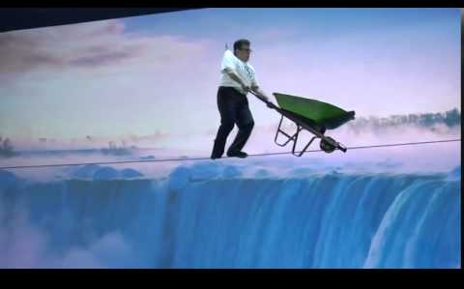
What is Faith?
“faith”
“believe”
“trust”

Slide 5
What is Faith?
“faith”
“believe”
“trust”
“receives” “comes”
“enters” “drinks”
“looks” “hears”

Slide 6
What is Faith?
“If anyone thirsts, let him come to Me and drink. He who believes in Me, as the Scripture has said, out of his heart will flow rivers of living water.” (John 7:37-38)

Slide 7
What is Faith?
There are No Qualifiers
“true” “real”
“sincere” “heartfelt”
“genuine”

Slide 8
What is Faith?
There are No Negative Qualifiers
“spurious” “false”
“insincere” “head”
“superficial”

Slide 9
What is Faith?
Faith always means,
“a conviction, or a belief (with certainty) that something is true or real.”

Slide 10
What is Faith?
Faith is the means by which we receive eternal life, and the full scope of salvation.

Slide 11
What is Faith?
Technically, faith does not save.
Faith is the instrumental means by which we are saved.
It is the object of faith that saves, which is Jesus.

Slide 12
What is Faith?
The Cross / Atonement is the basis by which salvation can be offered by God.
Faith is in Christ

Slide 13
What is Faith?
“We are not saved by how we believe, how sincerely we believe, or how much belief we have. Belief is belief. It is the object of one’s belief that makes the eternal difference.” (Charlee Bing)

Slide 14
What is Faith?
A believers position in Christ
is secure and sure,
our practice becomes the product of our completed state, and not part of it.

Slide 15
What is Faith?
Faith + Jesus = Eternal Life
F + J = EL

Slide 16
What is Faith?
Faith + Jesus = Eternal Life
+
Good Works = Abundant Life
F + J = EL + GW = AL

Slide 17

What is Faith?
Faith (Good Works) + Jesus = Eternal Life
F (GW) + J = EL

Slide 18

What is Faith?

Slide 19
What is Faith?
Faith is sufficient because, Christ’s death is sufficient.
Faith is sufficient because, Christ’s Word is sufficient.

Slide 20
What is Faith?
The Word is the agency by which faith is generated.
Faith is in His Word

Slide 21
What is Faith?
“So then faith comes by hearing, and hearing by the word of God.” (Romans 10:17)
Faith is in His Word

Slide 22
What is Faith?
“No one can come to Me unless the Father who sent Me draws him…” (John 6:44)
Faith is in His Word

Slide 23
What is Faith?
“Abraham believed God and it was counted to him as righteousness” (Genesis 15:6) When? After hearing the promise.
Faith is in His Word

Slide 24
What is Faith?
His Word is the only sufficient and objective basis by which we can know we are saved.
Faith is in His Word

Slide 25

What is Faith?
“Examine yourselves as to whether you are in the faith. Test yourselves….”
(2 Cor. 13:5)

Slide 26
What is Faith?
“Works are not a sufficient means of determining someone’s born again state”. (Jeremy Edmondson)

Slide 27
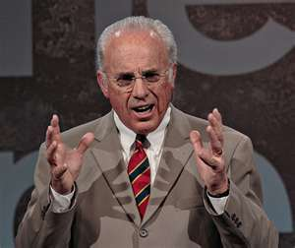
What is Faith?
“You don’t ever, ever evaluate your own spiritual life.” (Dr. John MacArthur)

Slide 28
What is Faith?
“Only free grace theology consistently and sufficiently keeps us focused on what Christ has done and not focused on ourselves” (Grant Hawley)

Slide 29
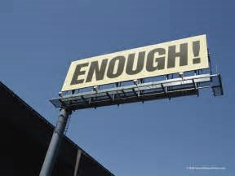
What is Faith?

Slide 30
What is Faith?
“I need no other argument,
I need no other plea,
It is enough that Jesus died, and that He died for Me.”

Slide 31
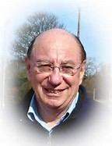
What is Faith?
An Interview with Dr. Michael Eaton

Slide 32

What is Faith?

Slide 33

What is Faith?
It Involves Me!

Slide 34
What is Faith?
“I need no other argument,
I need no other plea,
It is enough that Jesus died, and that He died for Me.”

Slide 35
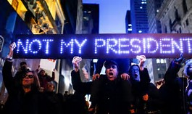
What is Faith?

Slide 36

What is Faith?
It Involves Inherent Ability

Slide 37
What is Faith?
All mankind has an inherent understanding of right and wrong, actions and deeds.

Slide 38
What is Faith?
Everyone has the inherent ability to exercise faith,
to believe, or not to believe.

Slide 39
What is Faith?
“Come to Me, all you who labor and are heavy laden, and I will give you rest.” (Matthew 11:28)

Slide 40
What is Faith?
“But you are not willing to come to Me that you may have life.” (John 5:40)

Slide 41
What is Faith?
“Free Grace affirms that mankind is totally depraved, unable to do anything to save himself, but we do not hold that mankind is unable to believe when presented with the gospel.” (Edmondson)

Slide 42
What is Faith?
Faith is not a gift of God!
This a misreading of
Ephesians 2:8-9
Faith is not by Grace!
Salvation is by grace, a gift of God.

Slide 43
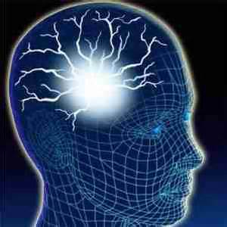
What is Faith?
Faith Involves the Intellect

Slide 44

What is Faith?
The Head and
the Heart
Faith Involves the Intellect

Slide 45
What is Faith?
The Head and
the Heart
Intellectual Assent / Agreement

Slide 46

What is Faith?
Faith Involves Facts

Slide 47
What is Faith?
“To be saved a person must believe in the person of Christ, the provisions of Christ and the promise of Christ.” (Charlie Bing)

Slide 48

What is Faith?
Faith is Knowable

Slide 49
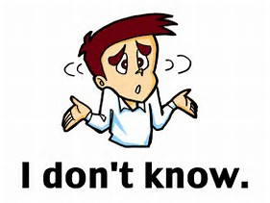
What is Faith?
We ourselves can know we are saved based on His Word.
Does God want us to be in doubt about our eternal destiny?

Slide 50
What is Faith?
Grudem does not provide the objective testimony of the Word as a proof of one’s saving faith.

Slide 51

What is Faith?
Faith is Assured

Slide 52
What is Faith?
The assurance of salvation comes from keeping our focus on Christ and what He has promised in His Word.

Slide 53
What is Faith?
And the Word provides the sufficient proof for absolute full assurance.

Slide 54
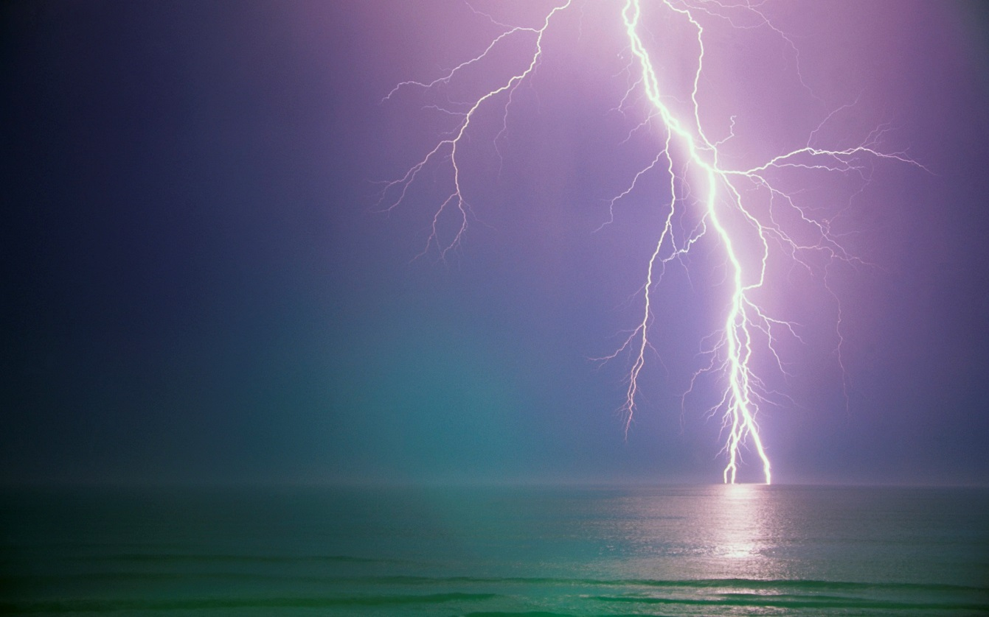
What is Faith?
Effectual
Faith has Results

Slide 55
What is Faith?
Initial faith
results in eternal life.
Continual faith
results in additional blessing and rewards.

Slide 56
What is Faith?
Justification by faith alone results in a change in our state.
Justification by works
results in a change in our
nature and status.

Slide 57
What is Faith?
Initial faith does not automatically produce spiritual transformation.
Continual faith is still needed to produce ongoing transformation of our body/flesh to bring it into conformity to our Spirit.

Slide 58
What is Faith?
Conclusion

Slide 59
What is Faith?
Simple
Enough
Sufficient
Particular
Factual
Universal
Knowable
Intellectual
Effectual
Assured

Slide 60
What is Faith?
Faith Alone
In
Christ Alone

